Slide 1











CS 2110 Lab 13: Intro to GBA Monday, March 28, 2022

Slide 2
Homework 7 — Intro to C
Covers introductory C concepts
Due Today at 11:59 PM
Files available on Canvas
Submit on Gradescope (unlimited submissions)
Standard grace period applies

Slide 3
Homework 8 — GBA
Create an interactive graphical application for the GameBoy Advance using C!
Releases Tuesday 3/29 (Tomorrow)
Due Next Monday 4/4 at 11:59 PM
Files available on Canvas
Submit on Gradescope (unlimited submissions)
Standard grace period applies
Will be demoed

Slide 4
Hiring Dates
Tuesday March 29 (tomorrow!) – Application opens
Tuesday April 5 – Application closes
One week window
April 8 and April 11 – TA interviews
April 11 night – TA selection

Slide 5


Slide 6
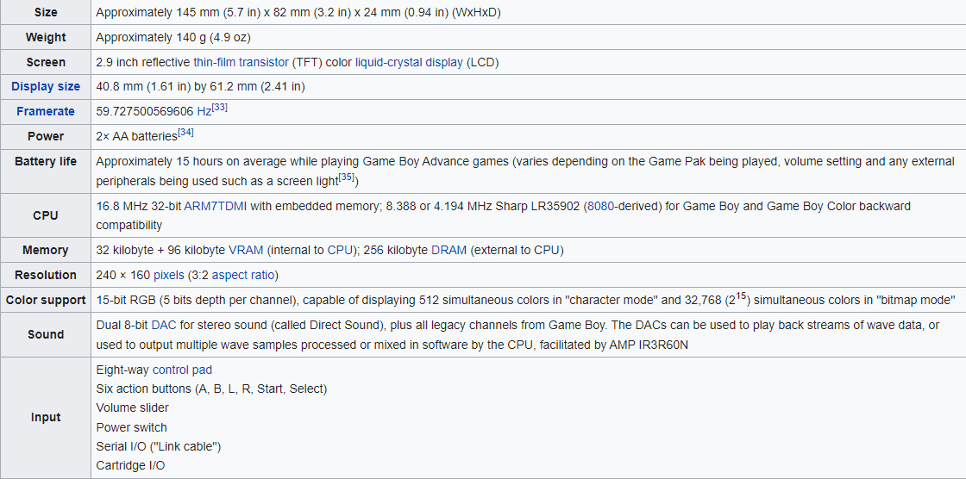
The Game Boy Advance

Slide 7
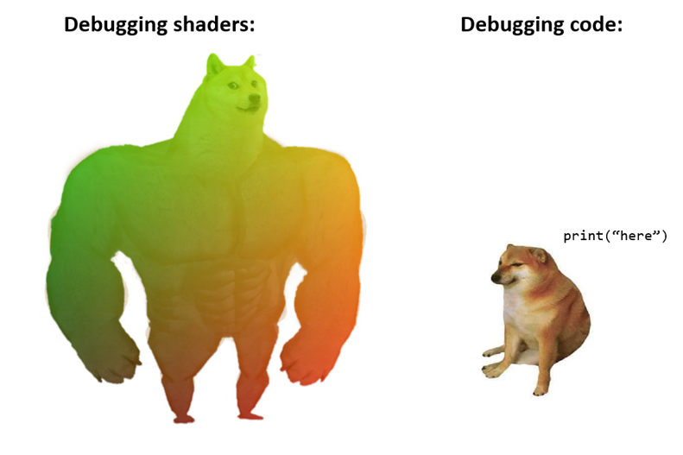
Graphics

Slide 8
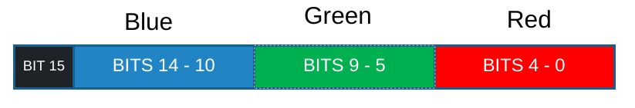
Colors
For HW8, you’ll be using a Game Boy Advance emulator; to display the game, you need to learn about GBA Graphics.
Pixel: 16-bit value
Each color is allotted 5 bits; you can have an intensity from 0 – 31.
Bit 15 is unused

Slide 9

Colors
Example colors:
0xFFFF → white
0x0000 → black
0x7C00 → pure blue
0x03E0 → pure green
0x001F → pure red
0x2110 →
You will use a macro to simplify this conversion.

Slide 10
Video Buffer
We use a “video buffer” to tell the GBA hardware what values we want to display on the screen
The 'videoBuffer' is simply a 1-D array of pixels.
But isn't our screen 2-D?
Yes! The screen is:
Displayed like this: But laid out like this in memory:
Row 0
Row 1
Row 0
Row 1
Row 2
Row 3
Row 4
Row 2
Row 3
Row 4

Slide 11
Video Buffer
(2, 0)
Col 0 ... Col WIDTH-1
videoBuffer
Row 0
Row 1
Row 2
Row 3
Row 4
Though our screen is stored like a 1-D array, we want a convenient way to index into a specific (row, col) coordinate.
Offset calculation:
uint16_t videobuffer[];
videoBuffer(row, col) = videobuffer + (row * WIDTH + col);
Note: WIDTH is the length of each row (the width of the screen)
You will also use a macro to simplify this calculation.

Slide 12

Video Buffer Example
What does this look like on a screen? (i.e. 13 x 13 pixels)
Col 7
videoBuffer[6 * 13 + 7] = 0x0000;
Row 6
WIDTH = 13

Slide 13
Graphics
The GBA's screen dimensions:
HEIGHT = 160
WIDTH = 240
How do we simulate movement?
We need to update the videoBuffer with the next position of our on-screen moving elements
We’ll touch on this more in the future!

Slide 14
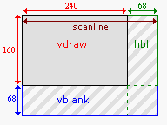
Draw Cycle
The GBA alternates between two phases: VDraw and VBlank.
VDraw: GBA copies one row of pixels at a time from the video buffer to the screen.
VDraw is not instantaneous: halfway through VDraw, only half the scanlines have been drawn.
VBlank: nothing happens.

Slide 15




Tearing
Example: Suppose all the pixels in the video buffer are red. We want to make the GBA screen blue.
Suppose VDraw starts while the video buffer is still all red, and then we update the video buffer to be all blue pixels before VDraw is completed. That would result in tearing (see the two examples below):
Tearing: the video buffer is updated during VDraw, causing the top half of the screen to show the old image and the bottom half to show the new image.
If we update the video buffer during VBlank, no tearing will happen, because the screen is not updated during VBlank.
Current video buffer:
What we want the screen to look like:
Resulting GBA Screen if the video buffer is updated early in VDraw:
Resulting GBA Screen if the video buffer is updated later in VDraw:

Slide 16
Synchronizing Drawing and Logic
Tearing looks bad, and we also need some way of synchronizing application logic.
Your HW8 applications are expected to have no tearing!
The GBA exposes the scanline counter as a memory-mapped device register; it can be read using the macro defined below.
The scanline counter indicates the current row of pixels being drawn at the screen (screen height: 160)
0 ≤ SCANLINECOUNTER ≤ 159: VDraw
160 ≤ SCANLINECOUNTER ≤ 227: VBlank
#define SCANLINECOUNTER *(volatile unsigned short *)0x4000006

Slide 17
Implementing waitForVBlank
How do we wait for VBlank?
SCANLINECOUNTER > 160 → the GBA is in VBlank
Issue #1: What if scanline is past 160, but almost at the end of VBlank? There’s not enough time to change the video buffer before VDraw.
Issue #2: What if app logic runs too quickly and we draw two frames during the same VBlank?
To avoid these issues, we always wait for the next full VBlank period
SCANLINECOUNTER == 160 exactly
Wait until scanline is past VBlank and then comes back to VBlank

Slide 18
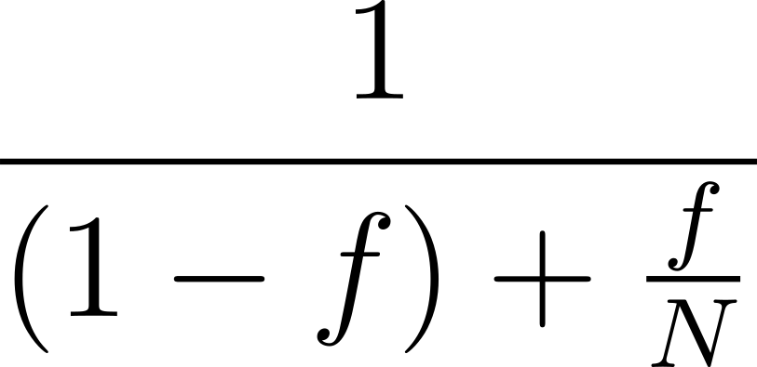
DMA

Slide 19

Direct Memory Access (DMA)
Drawing during VBlank helps prevent some tears, but unfortunately the GBA is not very powerful, and it's easy to draw too much and run out of VBlank time.
Only about 1600 pixels updates can be drawn during a single VBlank phase. Filling the entire screen (38400 pixels) takes several cycles, guaranteeing tearing.
Luckily, the GBA has a feature called Direct Memory Access, or DMA, which optimizes large array copies. Since filling the video buffer is basically an array copy, DMA is perfect for drawing!
DMA is fast, but it isn't instant. It can't draw a full-screen image in a single VBlank cycle, but it can draw without tearing (before VDraw catches up).
Like the scanline counter, DMA is manipulated using memory-mapped I/O.

Slide 20
The DMA Controller
The DMA controller is not connected to the CPU, but the CPU can control it by writing to specific memory locations.
When DMA operates, it "steals" cycles from the CPU, and will return control to the CPU once it completes.
There are 12 DMA registers for four DMA channels; each channel has a source, destination, and control register.
We will use channel 3, the general-purpose channel.

Slide 21
DMA Source and Destination Registers
Both the source and destination registers contain pointers
The destination register will typically be given a pointer to videoBuffer, potentially with some offset added
The source register will typically be given a pointer to an array of pixel values.
Alternatively, the source register can be a pointer to a constant color.

Slide 22
DMA Control Register
The control register sets a few different things, using different bits:
Whether DMA is currently enabled (En)
How many elements to copy over (N)
How to iterate through the destination (DA)
How to iterate through the source (SA)
Whether to copy halfwords (16-bit) or words (32-bit) (CS)
Options for iterating through destination/source
Increment the address with each element (low → high addresses)
Decrement the address with each element (high → low addresses)
Fix the address with each element (don't change it)

Slide 23
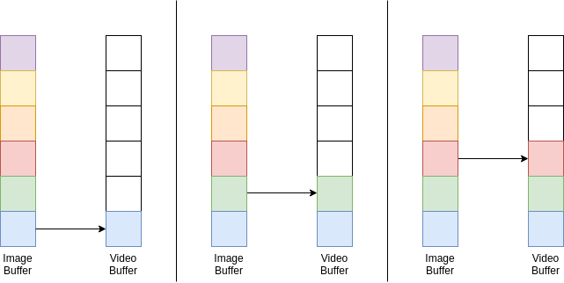
DMA Example: Image on Screen
When both the source and destination are set to increase after each copy, an element-wise copy will occur. This is useful for drawing images.

Slide 24
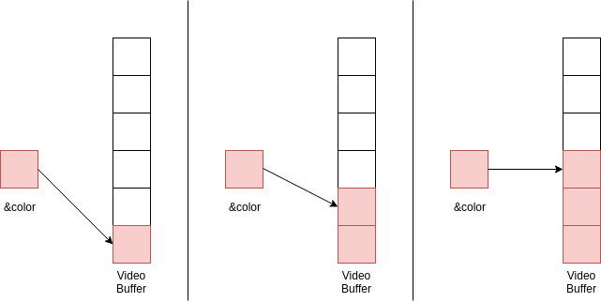
DMA Example: Color on Screen
If the destination is set to increment but the source is fixed, then a single value will be used to fill the entire buffer. This is useful for filling the screen with a single color (e.g., a solid background).

Slide 25

Non-Full Screen Images
So far, we have assumed a one-dimensional copy.
Works well for the full screen, because each row of the image will be back-to-back without any other pixels in-between.
However, DMA can only copy to and from contiguous addresses
Line will not be adjacent to the next line in the video buffer!
Consider that if we’re copying a rectangle smaller than the full screen, we’ll have to do the copy line-by-line.

Slide 26
Using DMA in code
DMA_CONTROLLER struct with the 3 registers:
typedef struct
{
const volatile void *src;
const volatile void *dst;
u32 cnt;
} DMA_CONTROLLER;
Array of 4 DMA controllers, one for each channel
DMA[3] is used to access channel 3
This is also memory-mapped I/O and allows us to control the DMA controller hardware
#define DMA ((volatile DMA_CONTROLLER *) 0x040000B0)

Slide 27
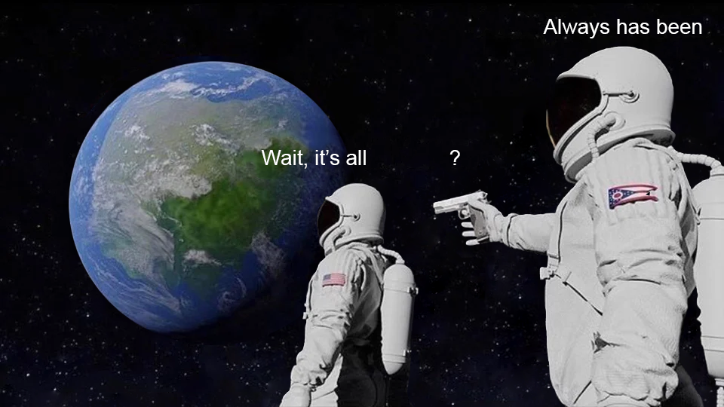
Games as State Machines
FSMs

Slide 28
GBA Program as a State Machine
Typically, it is convenient to structure programs as a state machine, where each state draws different images and has different criteria for transitioning to other states.
Example:
State 1: The start screen
Draws an image; transitions to State 2 when “start” is pressed
State 2: Core application
Contains the actual application—draws any necessary icons or images and transitions to State 3 if time expires
State 3: The “game over” or “application exited” screen
Draws an image; transitions to State 1 when “start” is pressed

Slide 29

Buttons
Another memory-mapped register the GBA exposes is the “key input” register
In this register, bits 15–10 are unused, and each button is assigned a single bit. The key states are low-active, meaning their bit is cleared when the button is pressed and set when it is released.
How can we extract a single bit from this whole number?
Hint: think back to HW1
Example: how can we get the value of the start button?
#define BUTTON_START (1<<3)
#define BUTTONS *(volatile u32 *) 0x4000130

Slide 30
Changing States on Button Presses
Idea:
#define KEY_DOWN(key, buttons) (~(buttons) & (key))
if (KEY_DOWN(BUTTON_A, buttons)) {
state = next_state;
}
Problem:
What if our next state wants to transition by pressing A also?
Most programs will run at 60 frames per second, so if the above code runs on the next frame, the player will only have a sixtieth of a second to lift the A button if they don't want to change to the next state.

Slide 31
Edge-Triggered State Changes
Solution: keep track of the previous button state
previousB = currentB;
currentB = buttons;
if (KEY_DOWN(BUTTON_A, currentB) && !KEY_DOWN(BUTTON_A, previousB)) {
state = next_state;
}
The above code will change the state only if the A button is currently pressed but was not pressed the last time the buttons were checked.
You will have to write a KEY_JUST_PRESSED macro to make the above more concise.

Slide 32
GBA Resources
https://www.coranac.com/tonc/text/
Covers all the topics discussed here, and much much more!
Sprites
Tilemaps
Note that if you try to implement audio (not taught in lecture/lab), the Docker environment will probably not support it

Slide 33
GBA Resources
ARMv7TDMI Technical Reference Manual: https://documentation-service.arm.com/static/5f4786a179ff4c392c0ff819
ARMv5 Architecture Reference Manual: https://documentation-service.arm.com/static/5f8dacc8f86e16515cdb865a
Nintendo’s AGB Programming Manual: https://archive.org/details/NintendoGbaManualV1.1
no$gba’s GBATEK: https://problemkaputt.de/gbatek.htm

Slide 34
Lab Assignment: Canvas Quiz
Go to Quizzes on Canvas
Select Lab 13
Password: BCSE
Get 100% for lab attendance credit
Unlimited attempts
Collaboration is encouraged!
Ask your TAs for help :)

